Slide 1

Document 10
Introduction of
Vitalizing Local Economy Organization by Open Data & Big Data
2017-05-11

Slide 2
History of establishment（設立の経緯）
July 2012
・Japanese government publishes
“Open Government Data Strategy”
July 2012
・Established
“Open Data Promotion Consortium”
October 2014
・Becoming a general incorporated association
・Change of name ”VLED”

Slide 3
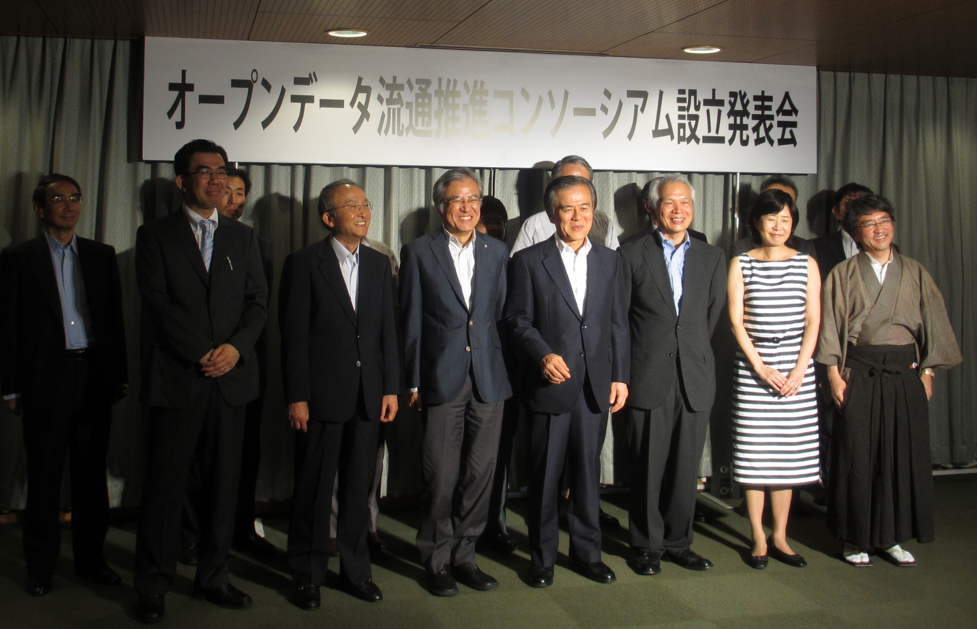

Established “Open Data Promotion Consortium”（July 2012）

Slide 4
Founding Memorial Party of VLED
& Award ceremony of Application contest （December 2014）

Slide 5
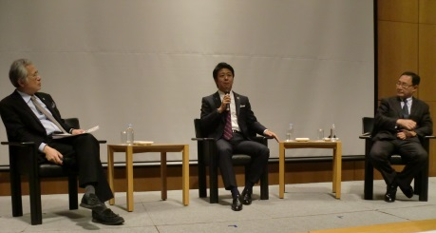
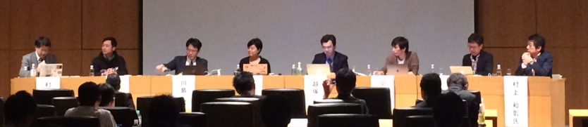
Main activities of VLED（主な活動）
Open Data symposium (2012-)

Slide 6
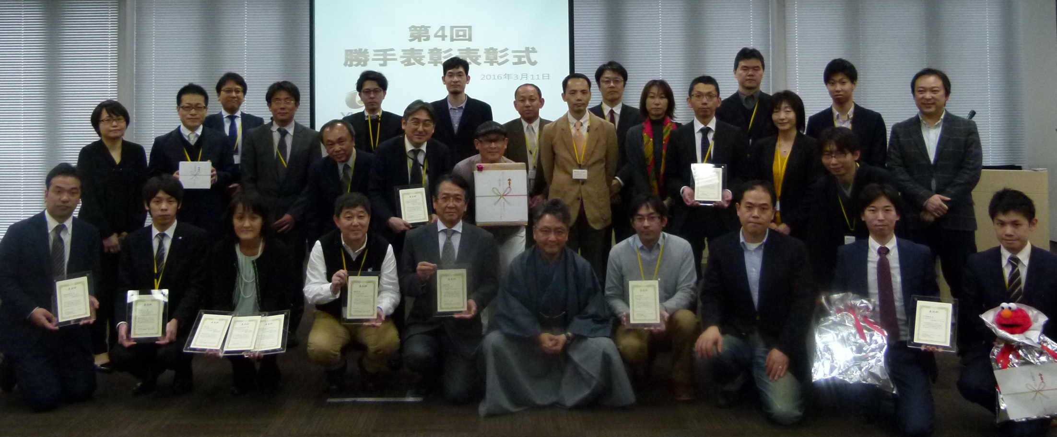
Recognition of outstanding efforts for Open Data (2012-)

Slide 7
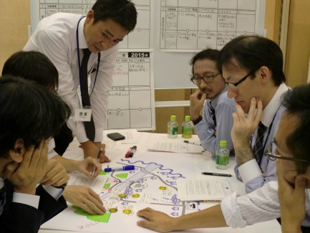
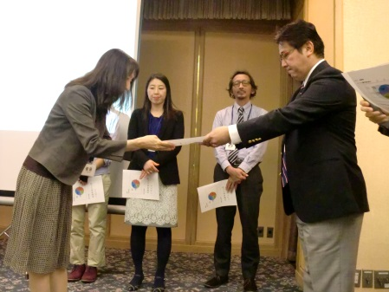
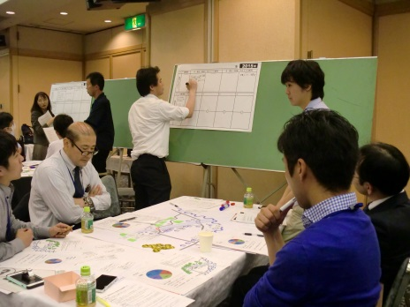
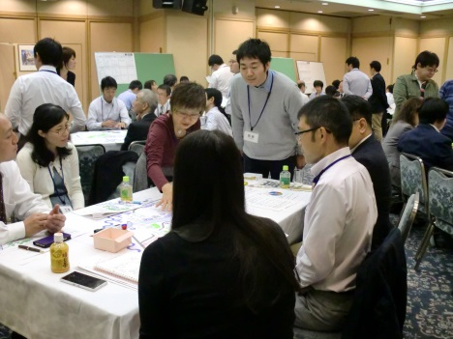
Open Data training for Local government officials（2015-）

Slide 8
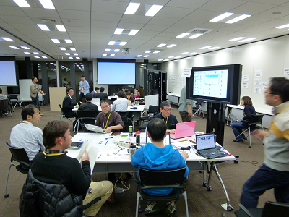
Meteorological Data Ideathon & Hackathon (2012)

Slide 9
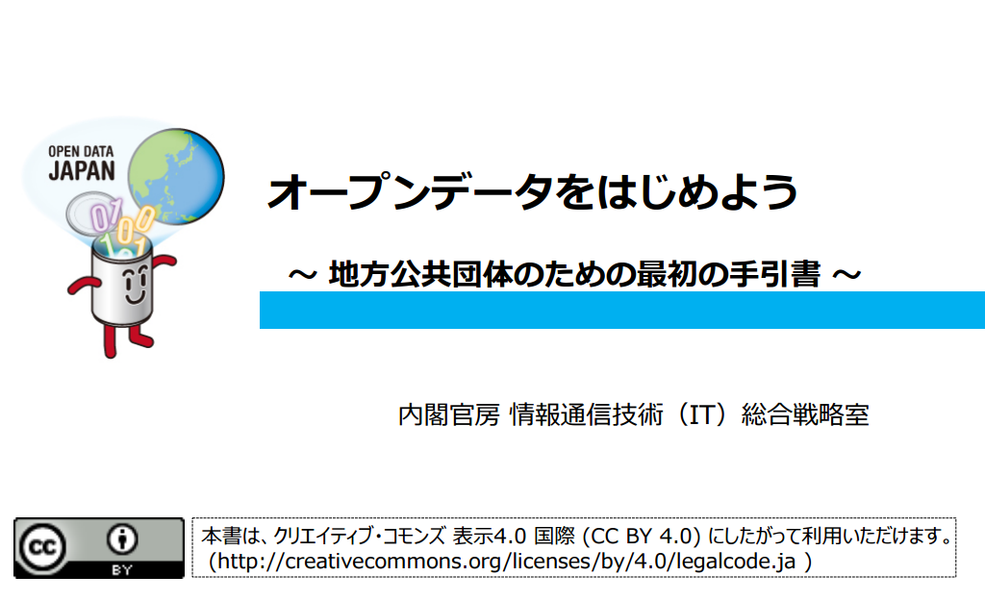

政府標準利用規約
Government Standard Terms of Service
1.0/2.0
And “Examination of external specifications”
“Open Data business case collection” etc.
Open Data license & Open Data guide（2012-）

Slide 10
Committee & Subcommittee
・Data Governance Committee
・Technical Committee
・Utilization and Promotion Committee
You are attending today!
・2020 Open Data City Promotion Committe
・Municipality Subcommittee
・Data Practical Use Consideration Subcommittee

Slide 11
データ運用検討分科会（2016-）
Using the following data as a preceding model, consider common data format among municipalities
・Road traffic regulation information
・Geological information (bowling investigation data)
・Administrative information（Food business relation permission information etc.）
Data Practical Use Consideration Subcommittee

Slide 12
構成
・Chief Counsel：Dr. Hiroshi Komiyama
・President：Dr. Ken Sakamura
・Board of Directors：
・KDDI CORPORATION
・DENTSU INC.
・Microsoft Corporation
・IBM Japan, Ltd.
・Nippon Telegraph and Telephone Corporation
・NEC Corporation
・Hitachi, Ltd.
・FUJITSU LIMITED
・Mitsubishi Research Institute, Inc.（Secretariat）
・Municipalities：71団体（As of April 13, 2017）
・Support Members：124団体

Slide 13

Thank you!

